Slide 1
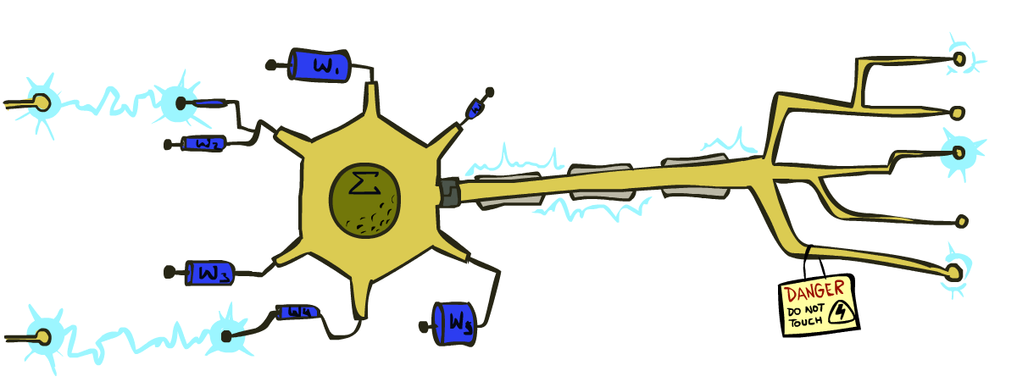
CS 188: Artificial Intelligence
Perceptrons and Logistic Regression
Instructor: Mesut Xiaocheng Yang, Carl Qi
University of California, Berkeley

Slide 2
Recap: Naïve Bayes
Bayes rule lets us do diagnostic queries with causal probabilities
The naïve Bayes assumption takes all features to be independent given the class label
We can build classifiers out of a naïve Bayes model using training data
Smoothing estimates is important in real systems
Classifier confidences are useful, when you can get them

Slide 3
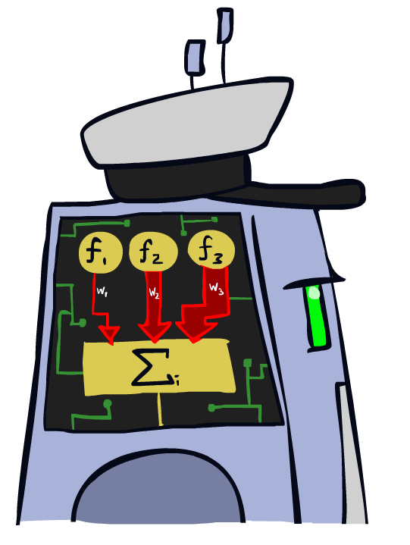
Linear Classifiers

Slide 4
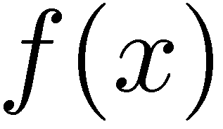

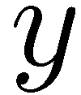

Feature Vectors
Hello,
Do you want free printr cartriges? Why pay more when you can get them ABSOLUTELY FREE! Just
# free : 2
YOUR_NAME : 0
MISSPELLED : 2
FROM_FRIEND : 0
...
SPAM
or
+
PIXEL-7,12 : 1
PIXEL-7,13 : 0
...
NUM_LOOPS : 1
...
“2”

Slide 5
Some (Simplified) Biology
Very loose inspiration: human neurons

Slide 6
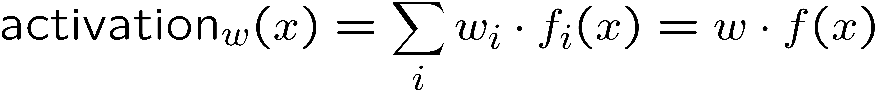
Linear Classifiers
Inputs are feature values
Each feature has a weight
Sum is the activation
If the activation is:
  Positive, output +1
  Negative, output -1
w₁
f₁
Σ
w₂
>0?
f₂
w₃
f₃

Slide 7

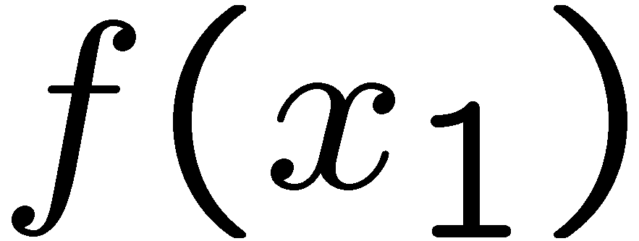
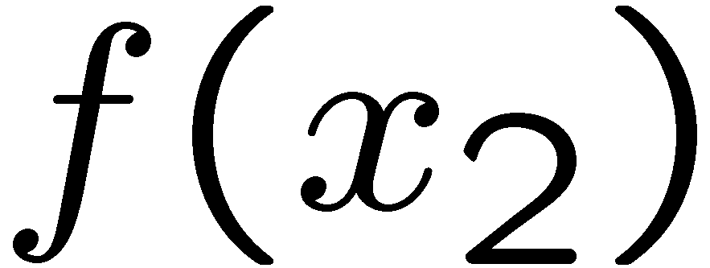
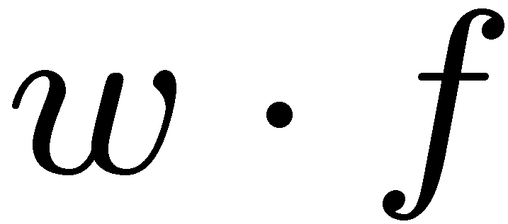
Weights
Binary case: compare features to a weight vector
Learning: figure out the weight vector from examples
# free : 4
YOUR_NAME :-1
MISSPELLED : 1
FROM_FRIEND :-3
...
# free : 2
YOUR_NAME : 0
MISSPELLED : 2
FROM_FRIEND : 0
...
# free : 0
YOUR_NAME : 1
MISSPELLED : 1
FROM_FRIEND : 1
...
Dot product positive means the positive class

Slide 8
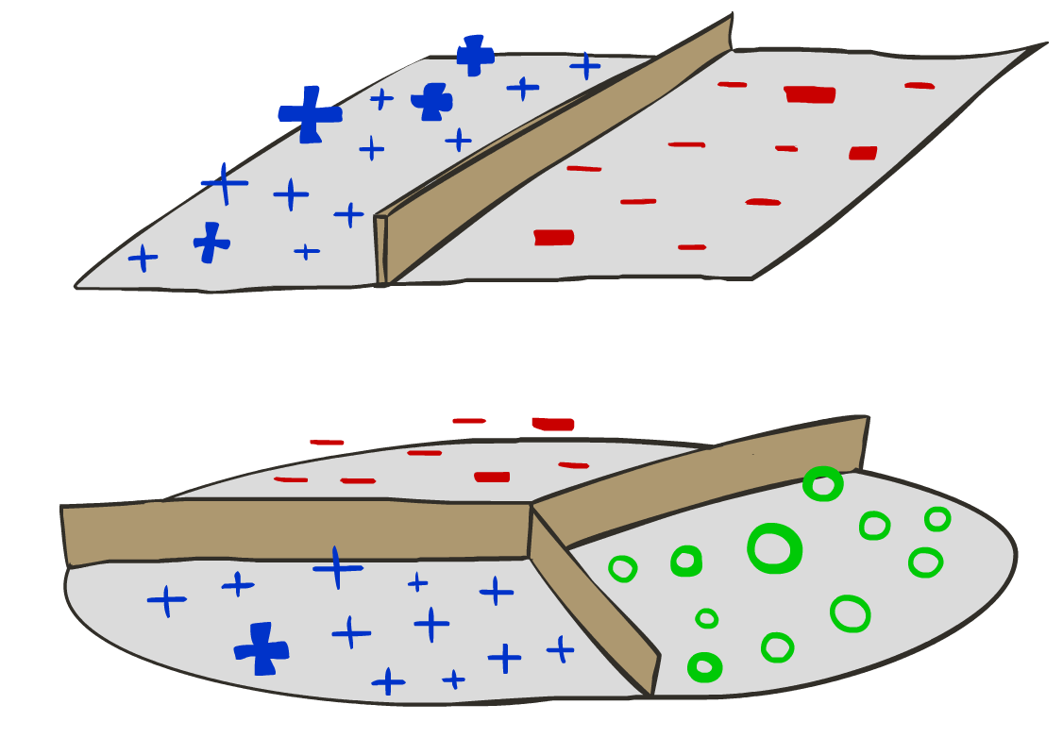
Decision Rules

Slide 9

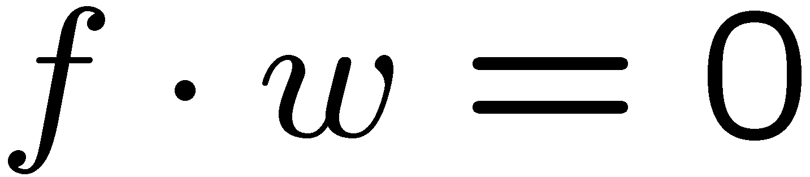
Binary Decision Rule
In the space of feature vectors
  Examples are points
  Any decision boundary is a hyperplane orthogonal to the weight vector
  One side corresponds to Y=+1
  Other corresponds to Y=-1
money
2
+1 = SPAM
1
BIAS : -3
free : 4
money : 2
...
0
-1 = HAM
0
1
free

Slide 10
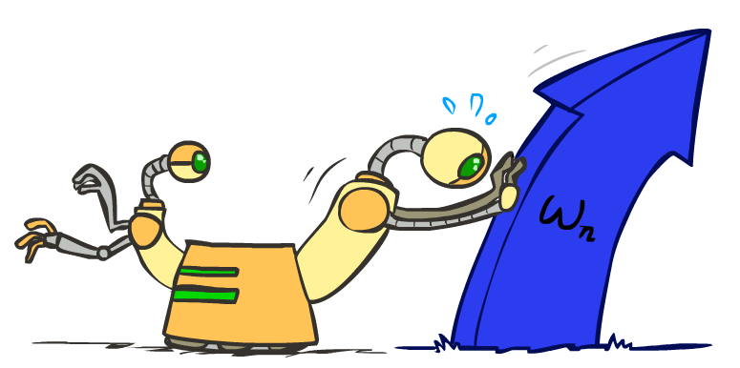
Weight Updates

Slide 11
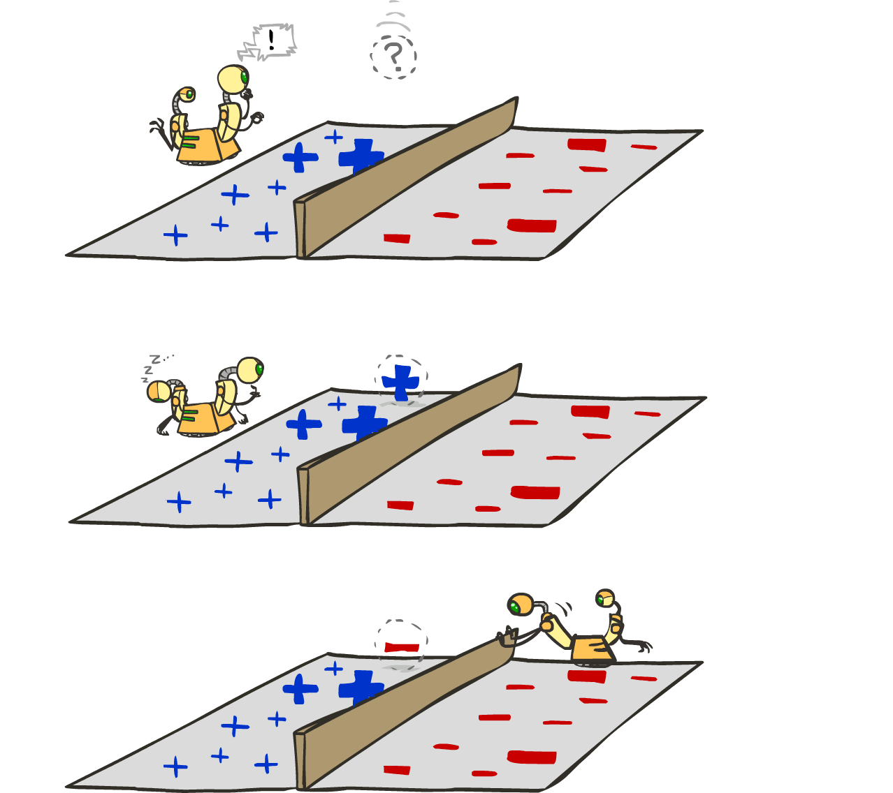
Learning: Binary Perceptron
Start with weights = 0
For each training instance:
  Classify with current weights
  If correct (i.e., y=y*), no change!
  If wrong: adjust the weight vector
Notes:
http://isl.ira.uka.de/neuralNetCourse/2004/VL_11_5/Perceptron.html

Slide 12
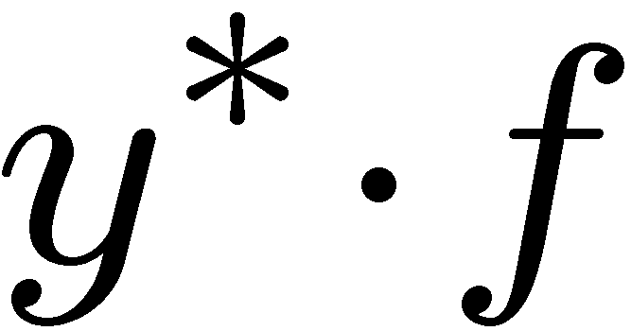
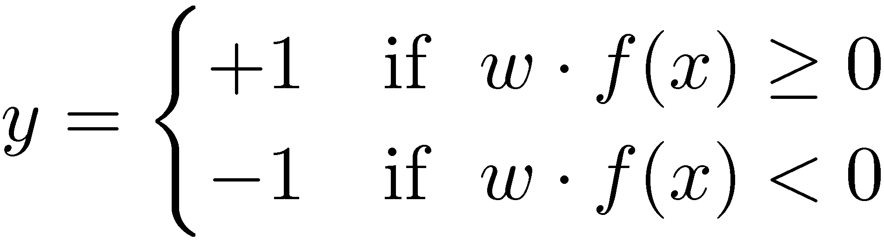

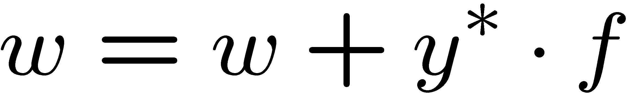
Learning: Binary Perceptron
Start with weights = 0
For each training instance:
  Classify with current weights
  If correct (i.e., y=y*), no change!
  If wrong: adjust the weight vector by adding or subtracting the feature vector. Subtract if y* is -1.
Notes:
http://isl.ira.uka.de/neuralNetCourse/2004/VL_11_5/Perceptron.html

Slide 13
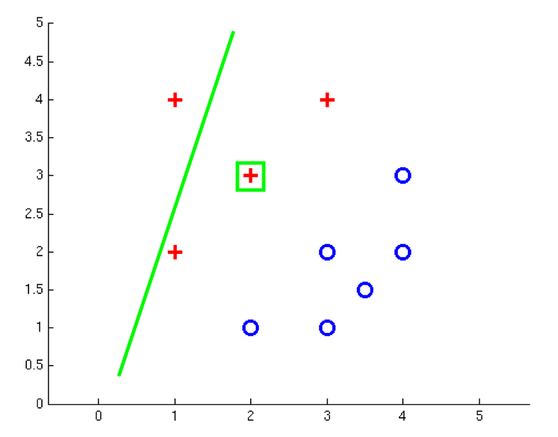
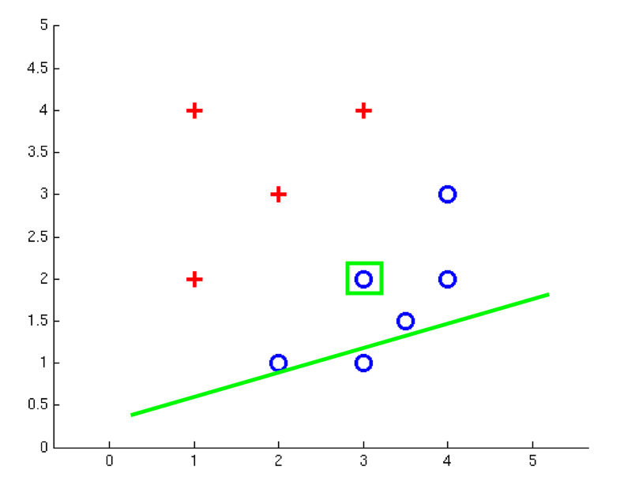
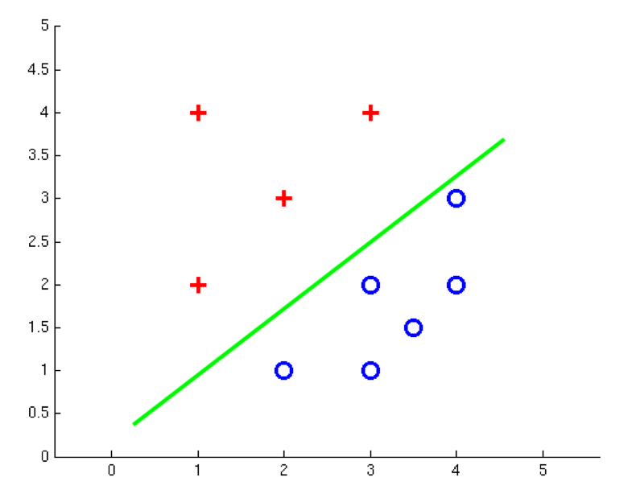
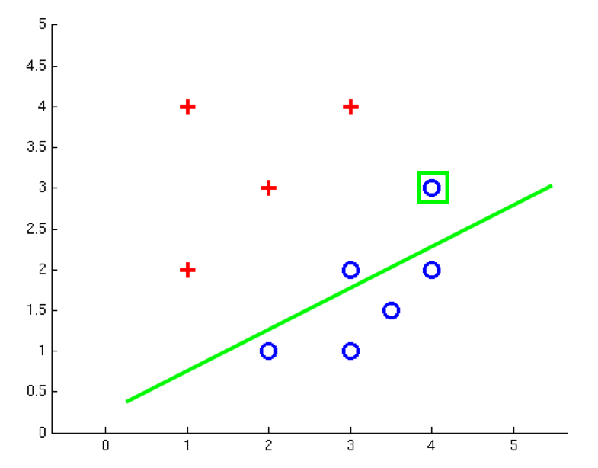
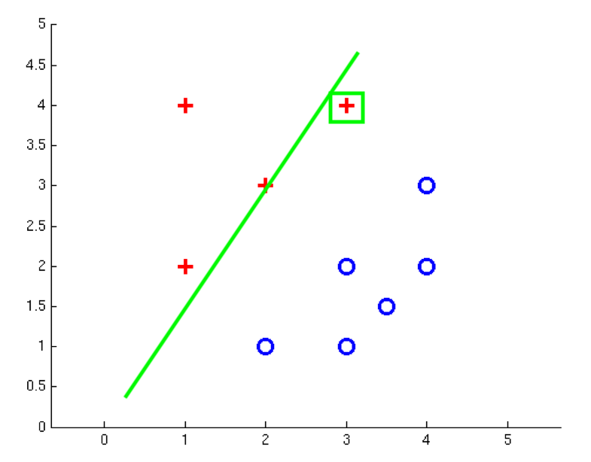
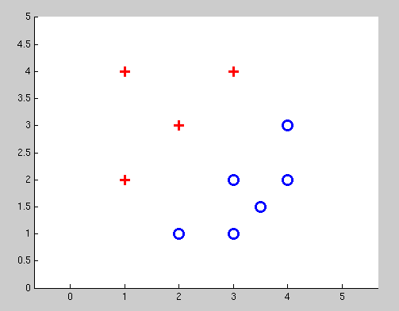
Examples: Perceptron
Separable Case

Slide 14


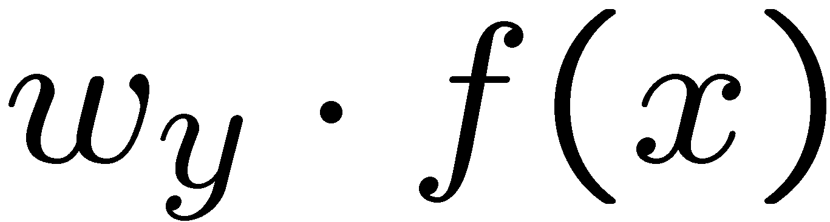


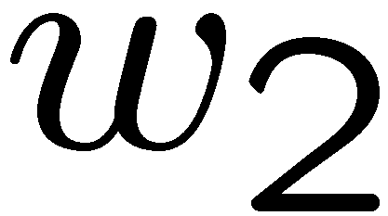
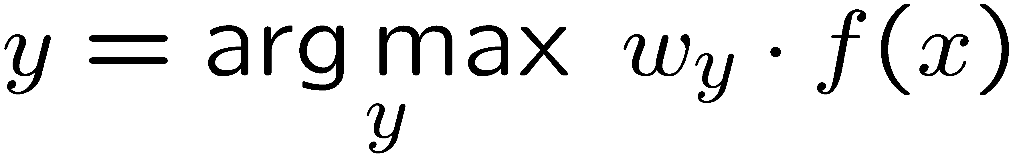
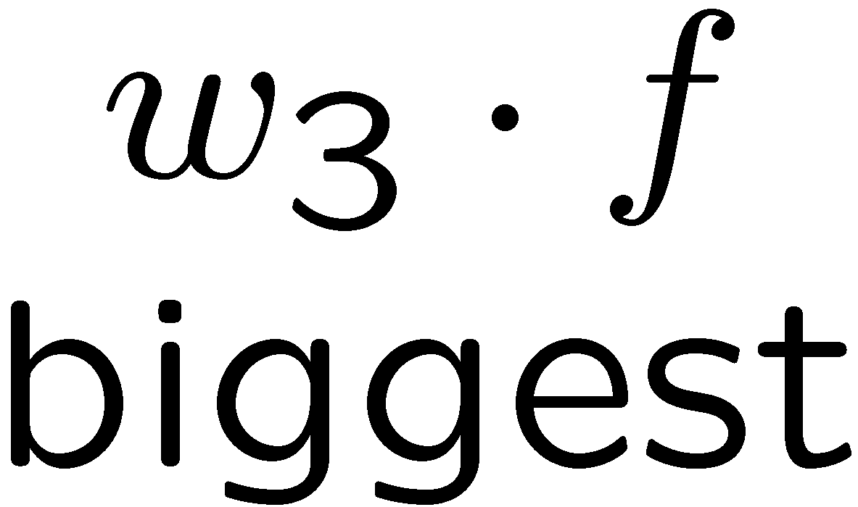
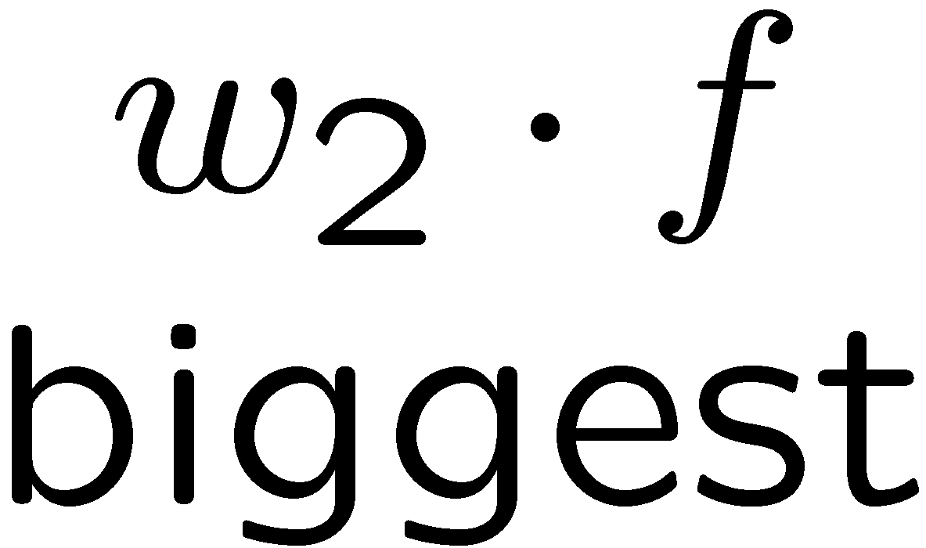
Multiclass Decision Rule
If we have multiple classes:
  A weight vector for each class:
  Score (activation) of a class y:
  Prediction highest score wins
Binary = multiclass where the negative class has weight zero

Slide 15

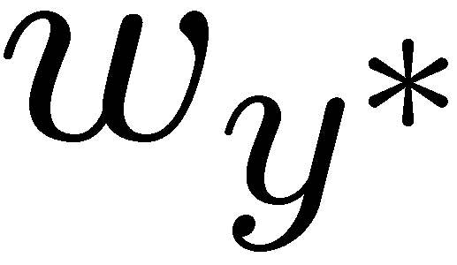

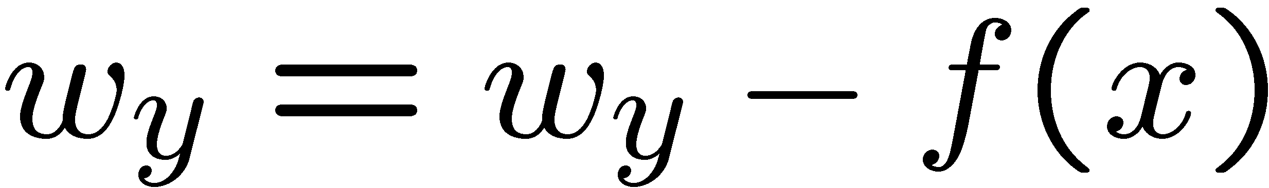
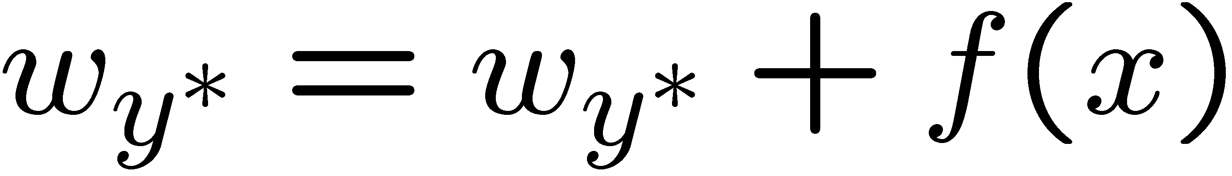
Learning: Multiclass Perceptron
Start with all weights = 0
Pick up training examples one by one
Predict with current weights
If correct, no change!
If wrong: lower score of wrong answer, raise score of right answer

Slide 16



Example: Multiclass Perceptron
“win the vote”
[1 1 0 1 1]
“win the election”
[1 1 0 0 1]
“win the game”
[1 1 1 0 1]
3
0
1
-2
0
3
0
-2
BIAS : 1
win : 0
game : 0
vote : 0
the : 0
...
0
-1
0
-1
-1
1
0
1
-1
0
BIAS : 0
win : 0
game : 0
vote : 0
the : 0
...
1
1
0
1
1
0
0
-1
1
0
BIAS : 0
win : 0
game : 0
vote : 0
the : 0
...

Slide 17
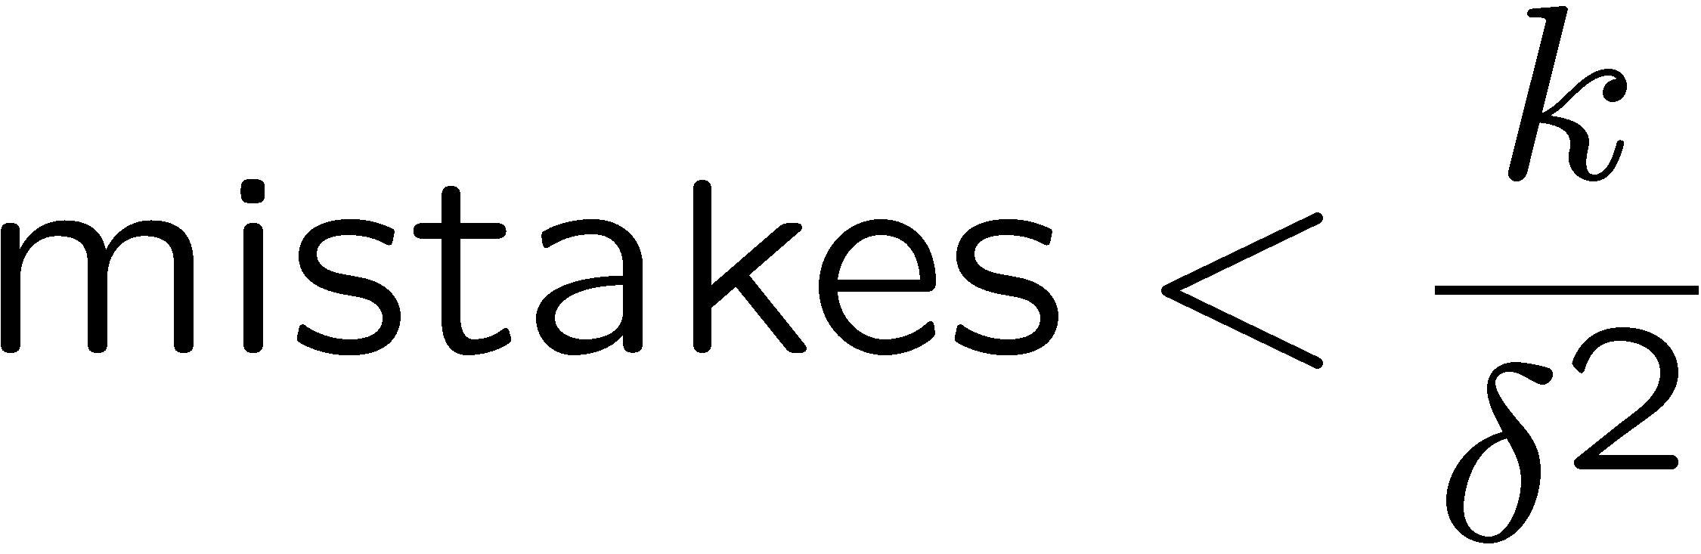
Properties of Perceptrons
Separable
Separability: true if some parameters get the training set perfectly correct
Convergence: if the training is separable, perceptron will eventually converge (binary case)
Mistake Bound: the maximum number of mistakes (binary case) related to the margin or degree of separability
Non-Separable
number of features
margin

Slide 18
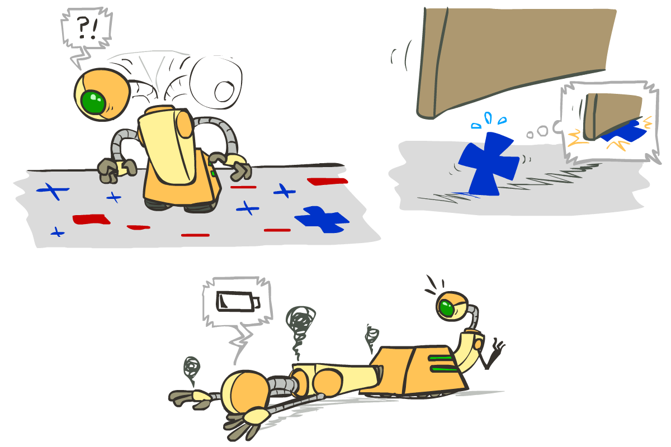





Problems with the Perceptron
Noise: if the data isn’t separable, weights might thrash
  Averaging weight vectors over time can help (averaged perceptron)
Mediocre generalization: finds a “barely” separating solution
Overtraining: test / held-out accuracy usually rises, then falls
  Overtraining is a kind of overfitting

Slide 19
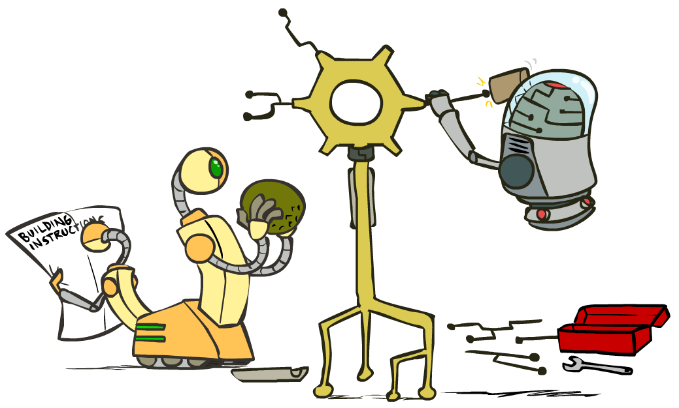
Improving the Perceptron

Slide 20
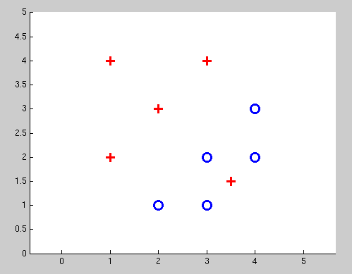
Non-Separable Case: Deterministic Decision
Even the best linear boundary makes at least one mistake

Slide 21
Non-Separable Case: Probabilistic Decision
0.9 | 0.1
0.7 | 0.3
0.5 | 0.5
0.3 | 0.7
0.1 | 0.9

Slide 22
How to get probabilistic decisions?
Perceptron scoring:
If very positive → want probability going to 1
If very negative → want probability going to 0
Sigmoid function

Slide 23



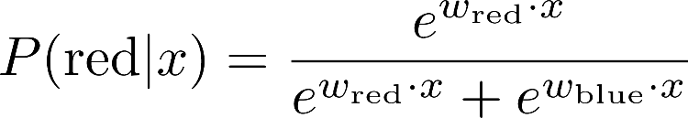
A 1D Example
definitely blue
not sure
definitely red
probability increases exponentially as we move away from boundary
normalizer

Slide 24
Best w?
Maximum likelihood estimation:
with:
= Logistic Regression

Slide 25
Separable Case: Deterministic Decision – Many Options

Slide 26
Separable Case: Probabilistic Decision – Clear Preference
0.7 | 0.3
0.5 | 0.5
0.7 | 0.3
0.3 | 0.7
0.5 | 0.5
0.3 | 0.7

Slide 27
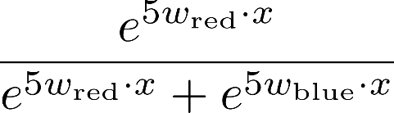
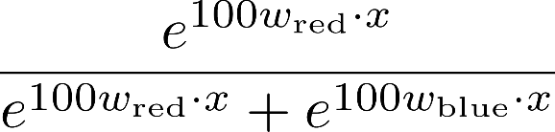

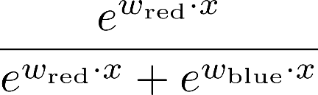
The Soft Max

Slide 28
Multiclass Logistic Regression
Recall Perceptron:
  A weight vector for each class:
  Score (activation) of a class y:
  Prediction highest score wins
How to make the scores into probabilities?
original activations
softmax activations

Slide 29
Best w?
Maximum likelihood estimation:
with:
= Multi-Class Logistic Regression

Slide 30
Next Lecture
Optimization
  i.e., how do we solve:

